Slide 1
Introduction to Computing for Data Analysis
Does my (numerical) program compute the right answer?
Richard Vuduc, Ph.D.
Associate Professor
School of Computational Science and Engineering
Representing numbers (namely, integers)
Notes:
Kids! It’s good to see you again.
So, you are a data analyst out in the world, writing code to crunch numbers.
Here is a question: How do you know your code produces the right answer?
This seemingly simple question is a surprisingly complex topic!
To understand how to even begin answering the question, we’ll need to think hard about a really fundamental question that, at first glance, sounds really dumb.
Namely, how do you store a number on a computer?

Slide 2
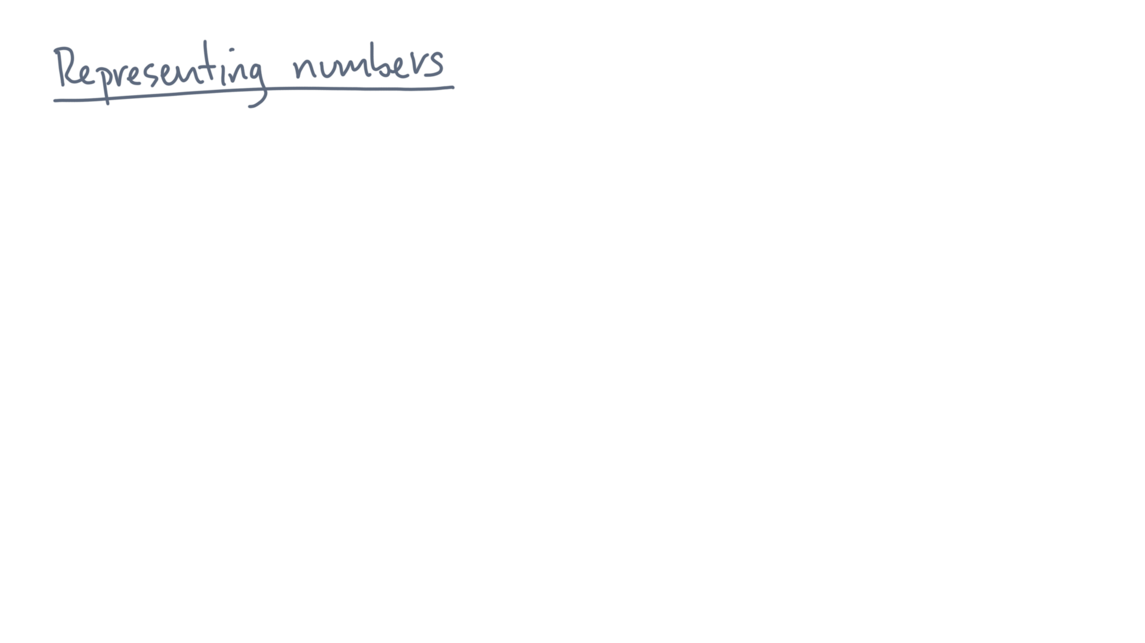
Notes:
Suppose you have some number, like, I don’t know.
Let’s say this one.

Slide 3
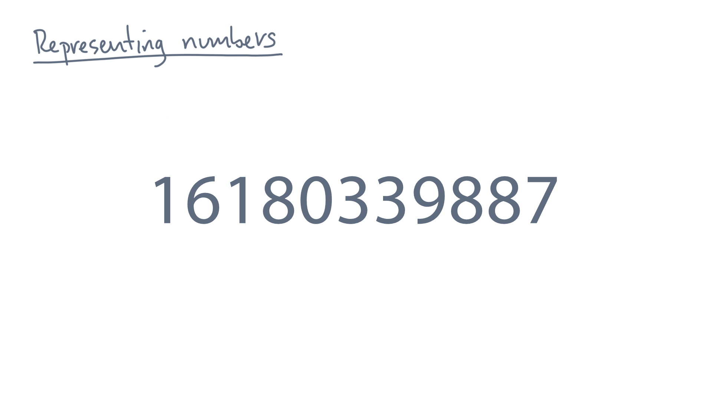
Notes:
What you see is a *string* of digits.

Slide 4
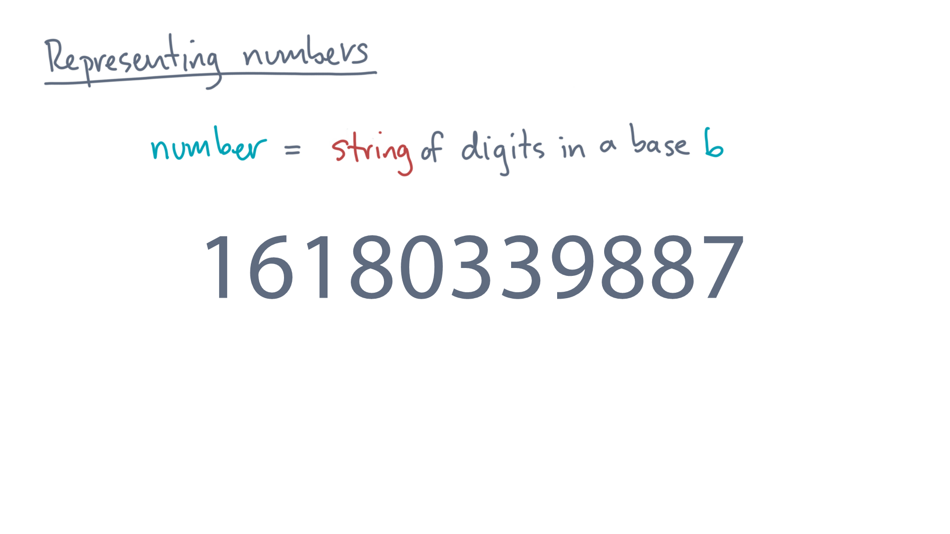
Notes:
Each digit goes from 0 through 9, which is 10 possible values.
Therefore, we say the *base* of this string is 10, denoted by “little bee.”
Just to be clear, the string you see represents some concrete mathematical *value*.
So to ask for that value, let’s enclose the string by a set of brackets.

Slide 5
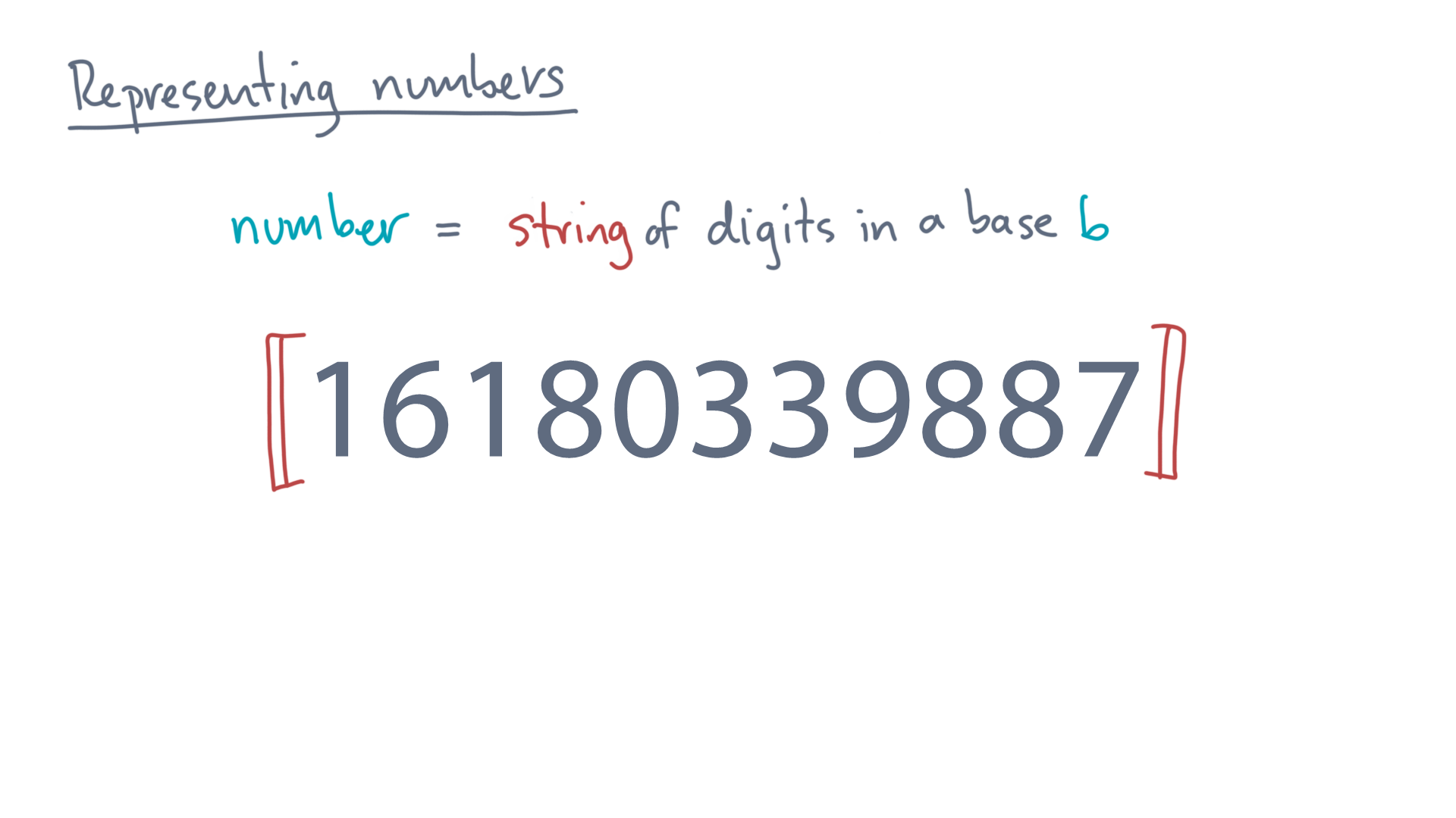
Notes:
So what does this notation mean?

Slide 6
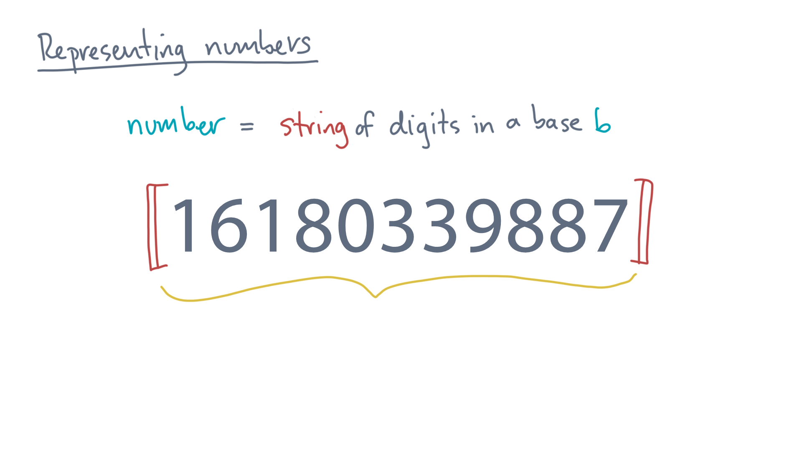
Notes:
Think of it as saying, “given a string 1-6-1-8-blah-blah-blah”, give me the number it represents.

Slide 7
Notes:
In a moment, you will think about number systems in bases other than ten.

Slide 8
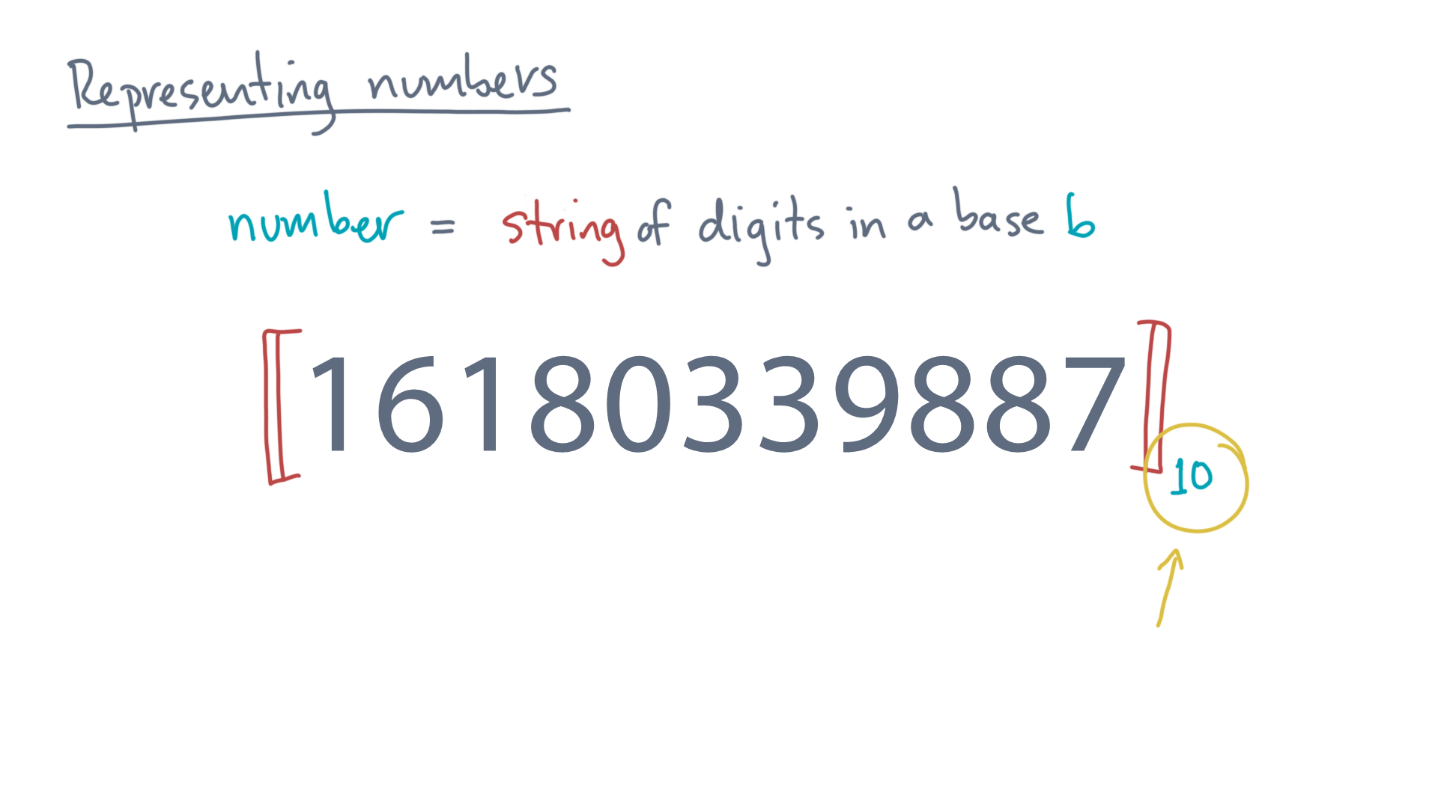
Notes:
So let’s denote the base explicitly.

Slide 9
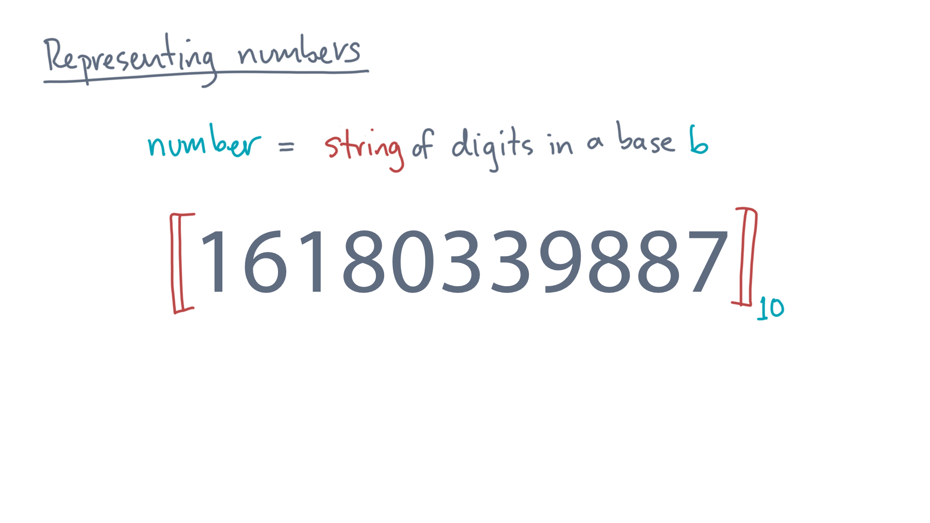
Notes:
Next, observe that every digit has a *place* in the string.

Slide 10
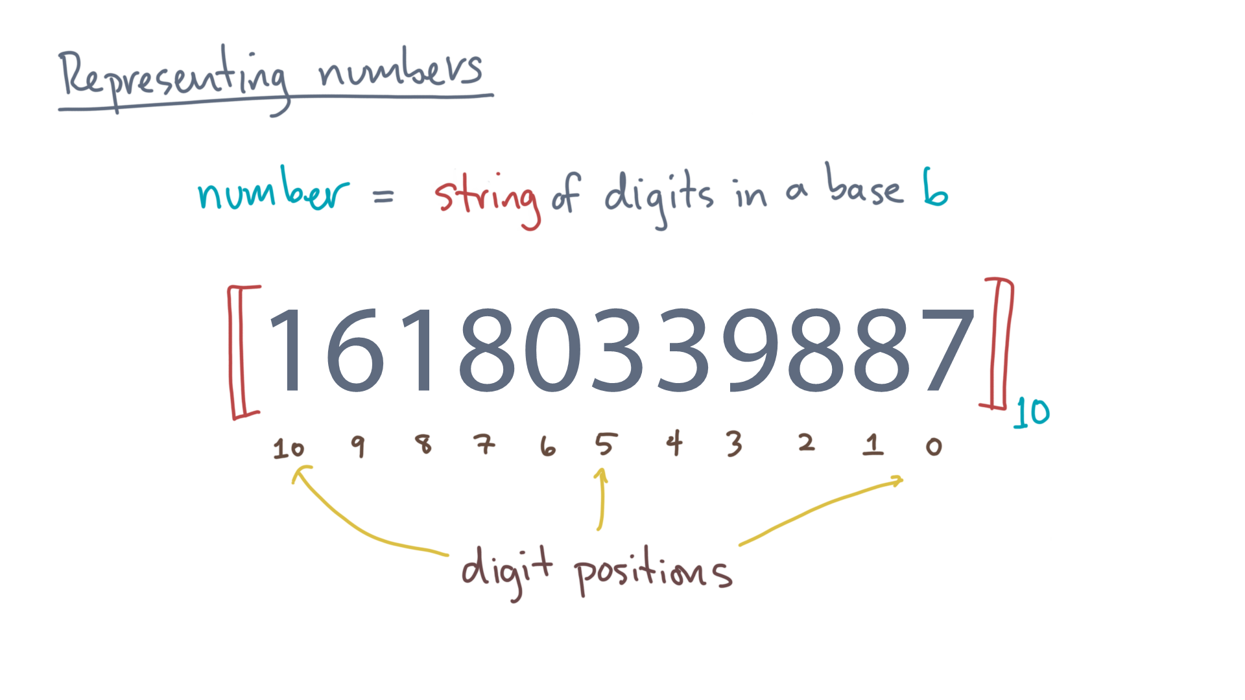
Notes:
Let’s number these.
In this example, the places or positions go from 0 to 10, since there are 11 digits.

Slide 11
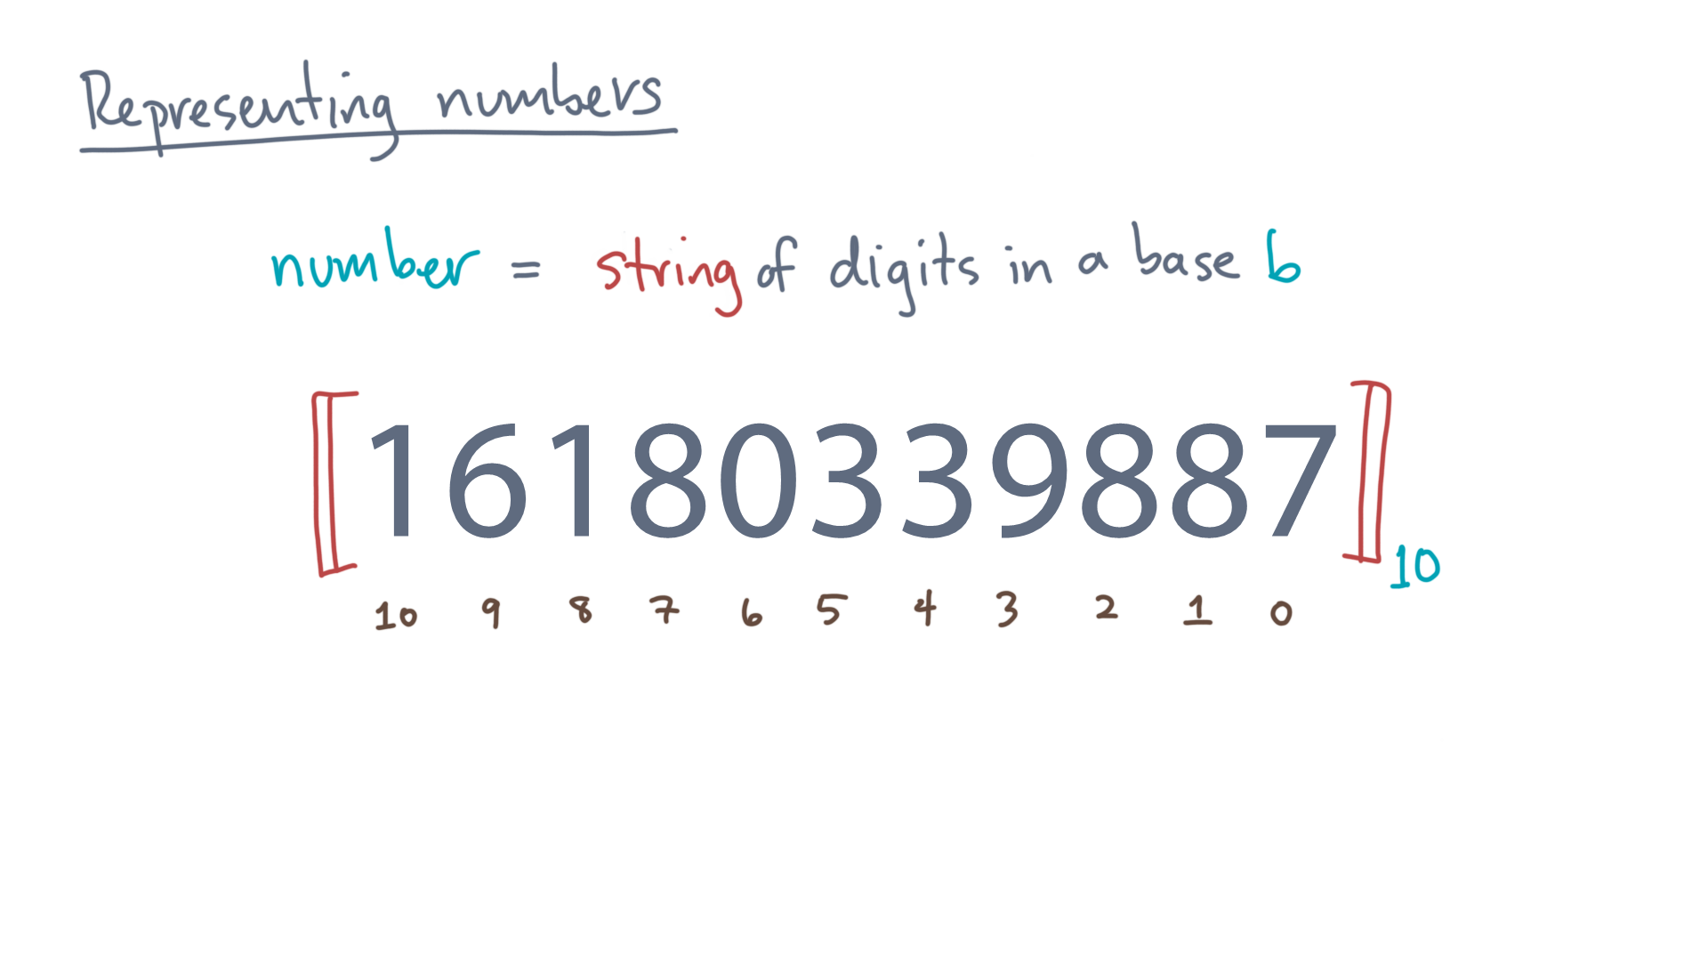
Notes:
Given the string, how do you compute its mathematical value?
Well, each digit contributes. For instance, consider the rightmost “7”.

Slide 12
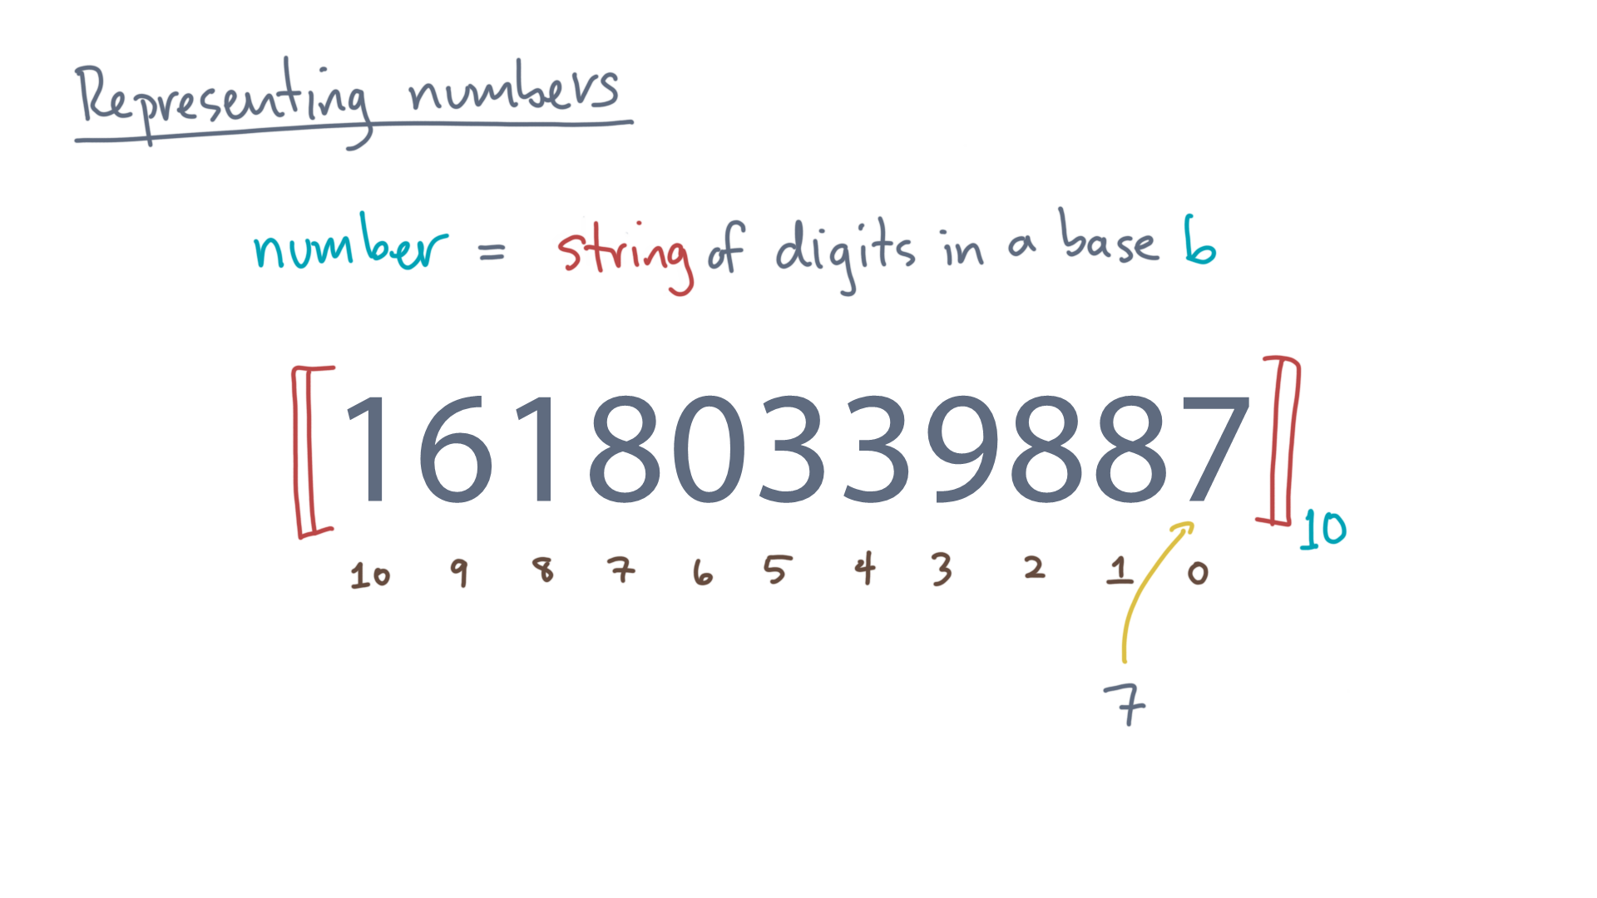
Notes:
It contributes a value of, well, seven!

Slide 13
Notes:
What about the rightmost eight?

Slide 14
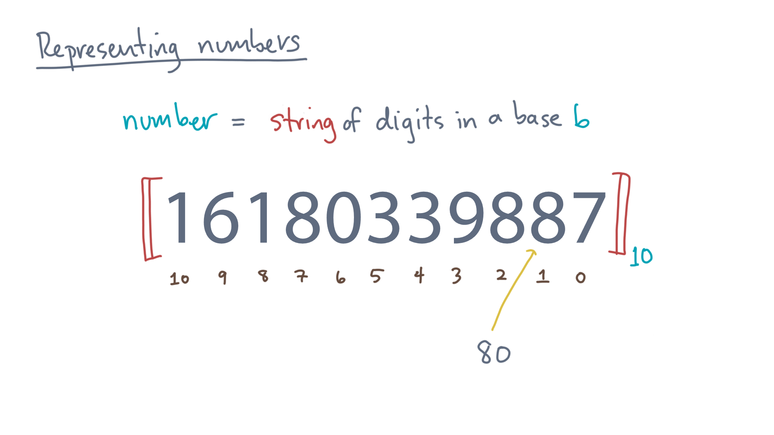
Notes:
It contributes “80” to the value.

Slide 15
Notes:
Continuing, what about the “8” that sits in position 7?

Slide 16
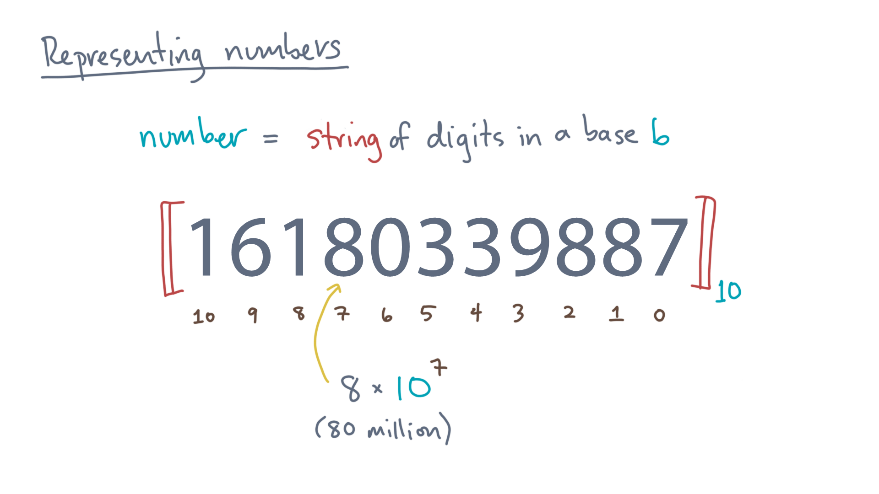
Notes:
It contributes 8 times 10 to the 7th power, or 80 million.

Slide 17
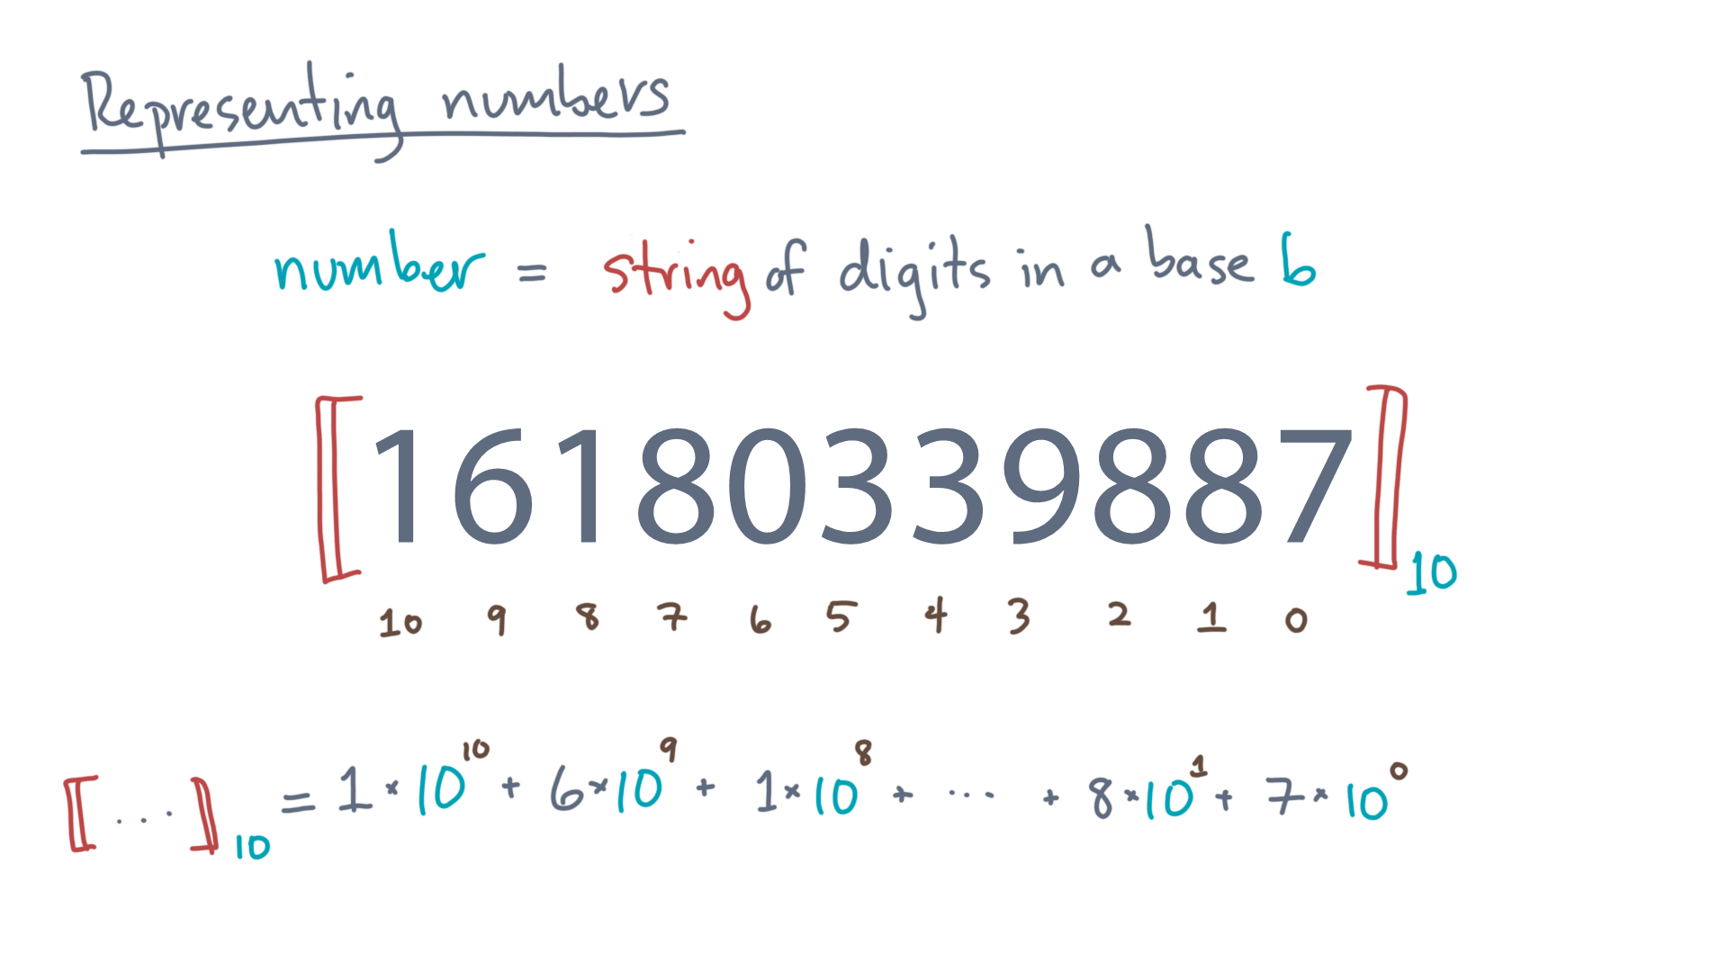
Notes:
Repeating for every digit, the value of the string is, naturally, the sum of what each digit contributes.
One times 10 to the 10th, plus 6 times 10 to the 9th, and so on.

Slide 18
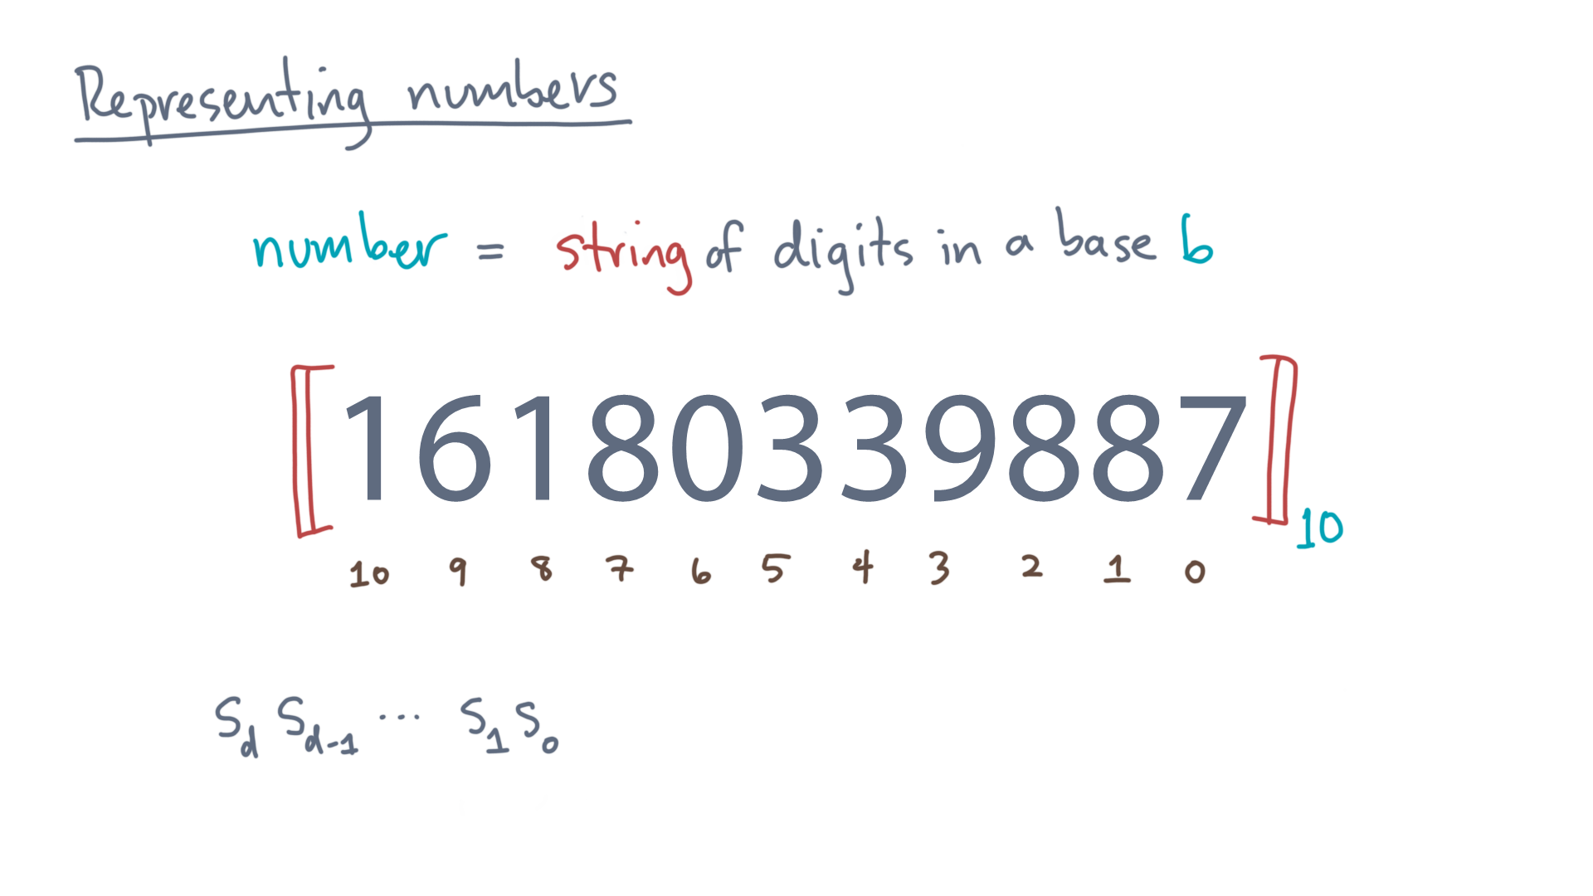
Notes:
Generalizing, consider *any* string of d+1 digits.

Slide 19
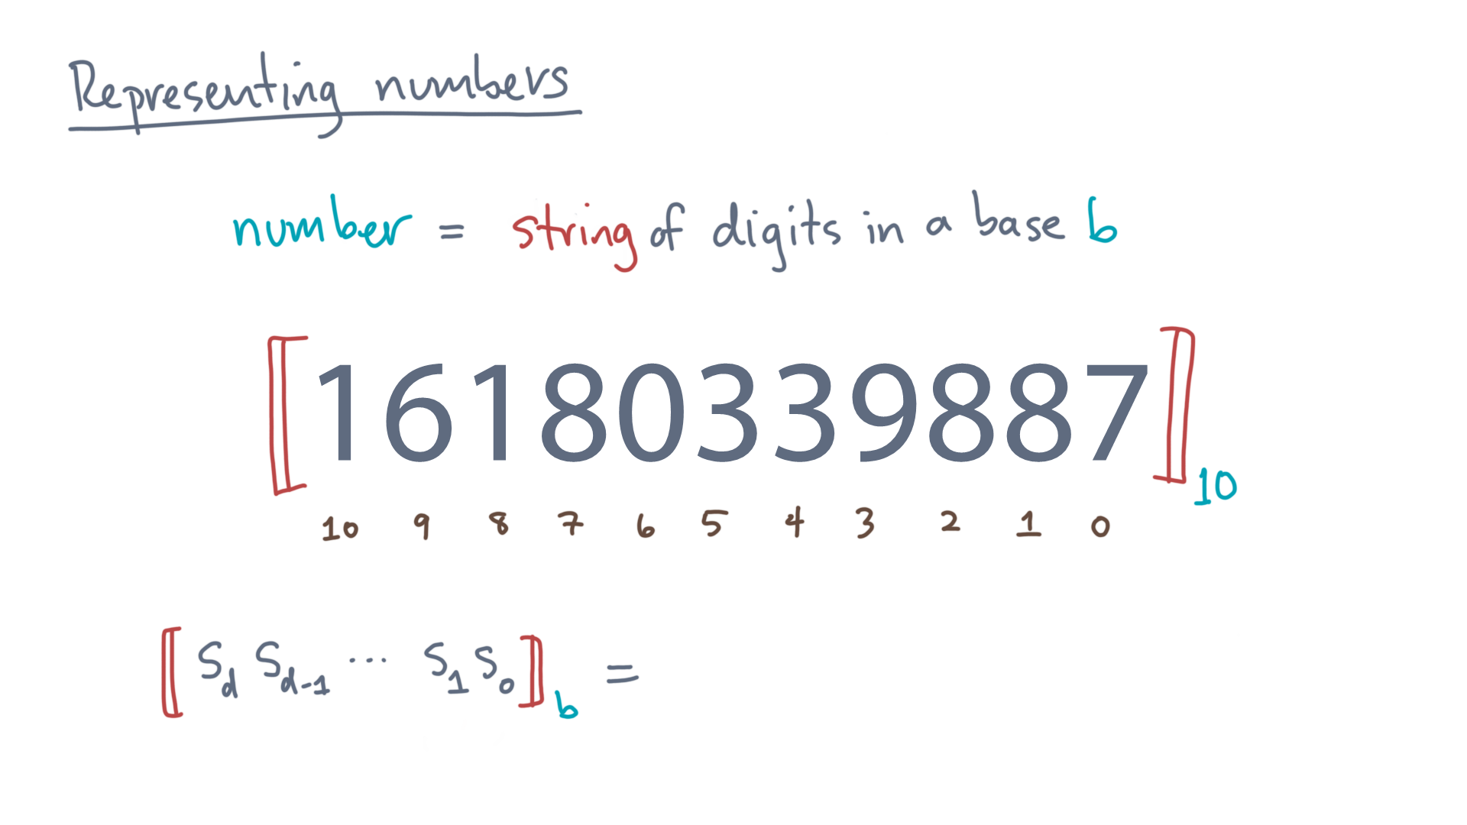
Notes:
What is *its* value, assuming the digits are given in base b?

Slide 20
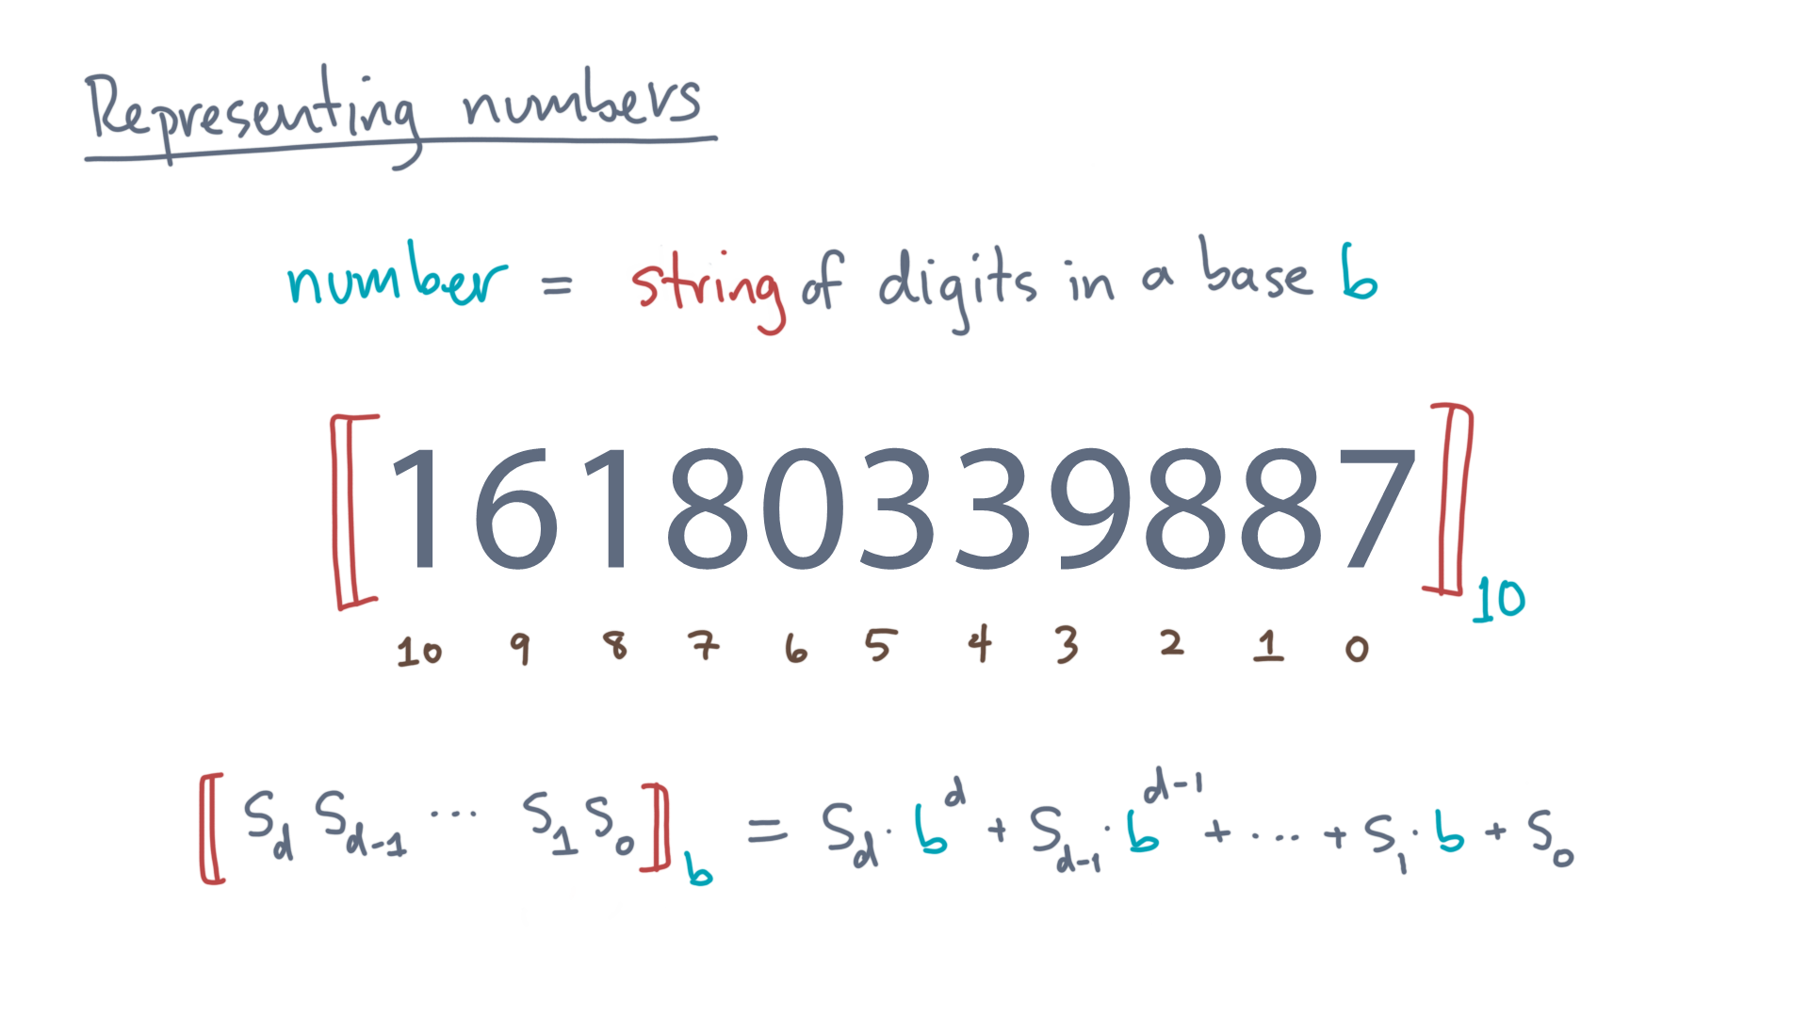
Notes:
Its basically the sum of each digit times the base raised to the digit’s position.
Or more compactly, this series.

Slide 21
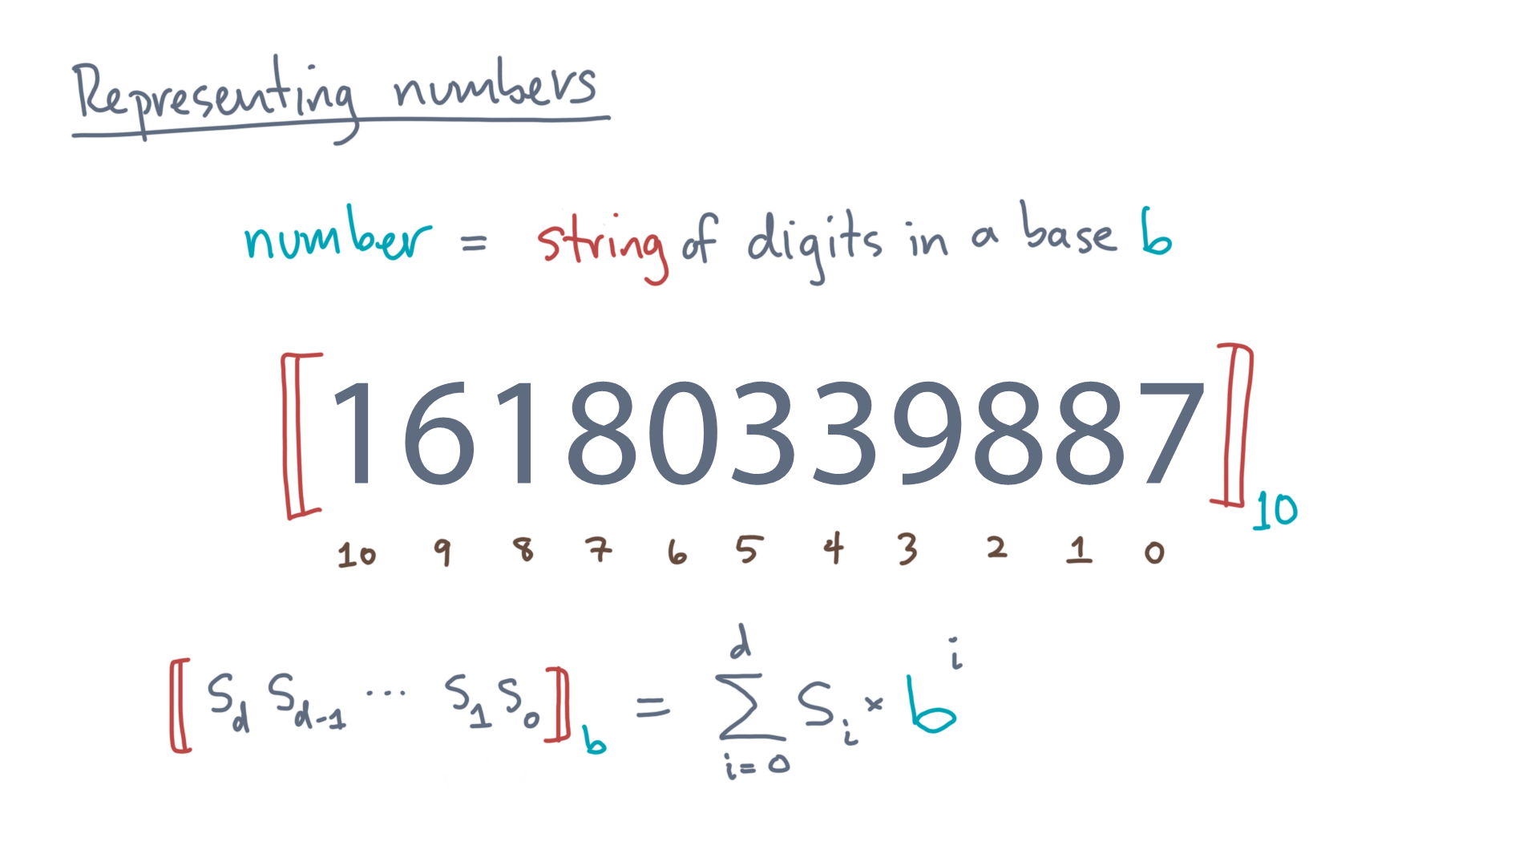
Notes:
I realize that seems like a lot of notation for something simple.
But you need a solid and precise foundation to understand how numbers are represented in the machine.

Slide 22

Notes:
Let’s see how, by changing the base!
As you probably know, computer hardware doesn’t store numbers as strings of decimal digits.

Slide 23
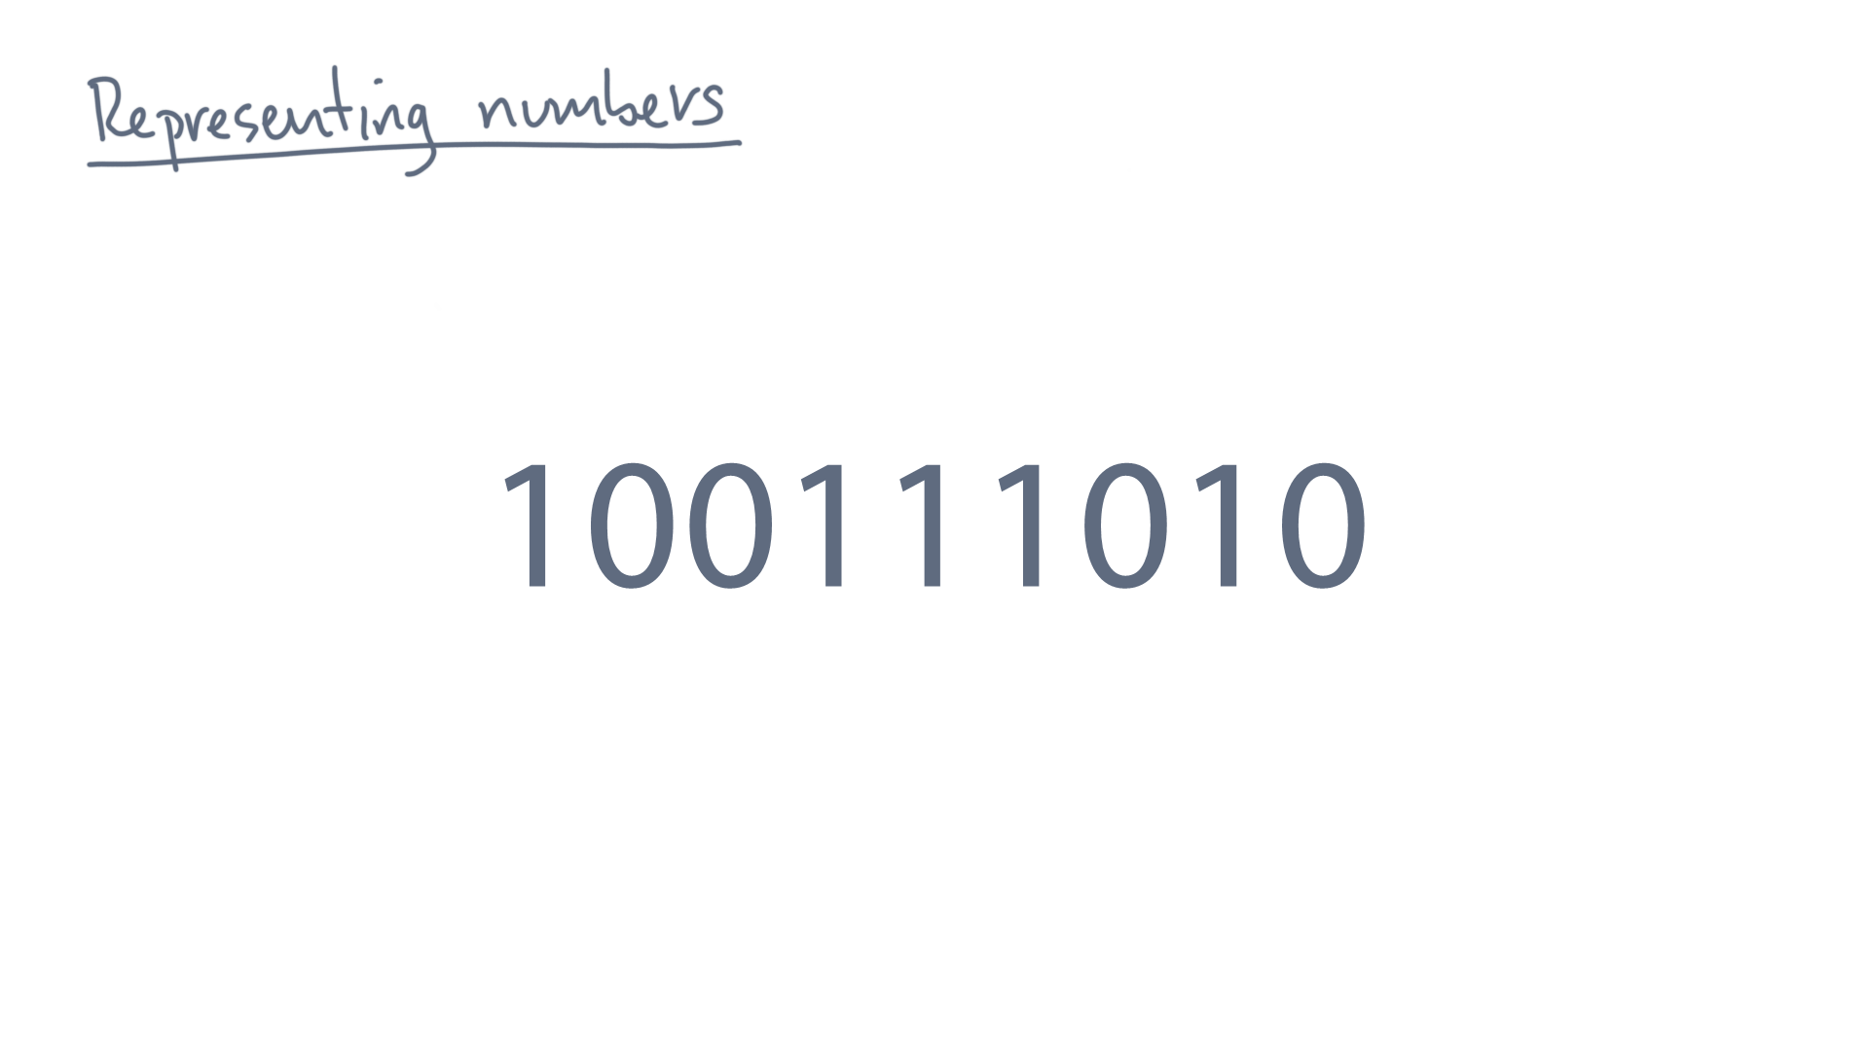
Notes:
Rather, it uses *binary* digits, or base 2, as you see in this example.
So every digit is either a 0 or a 1.
So, what’s the value of this binary string?

Slide 24
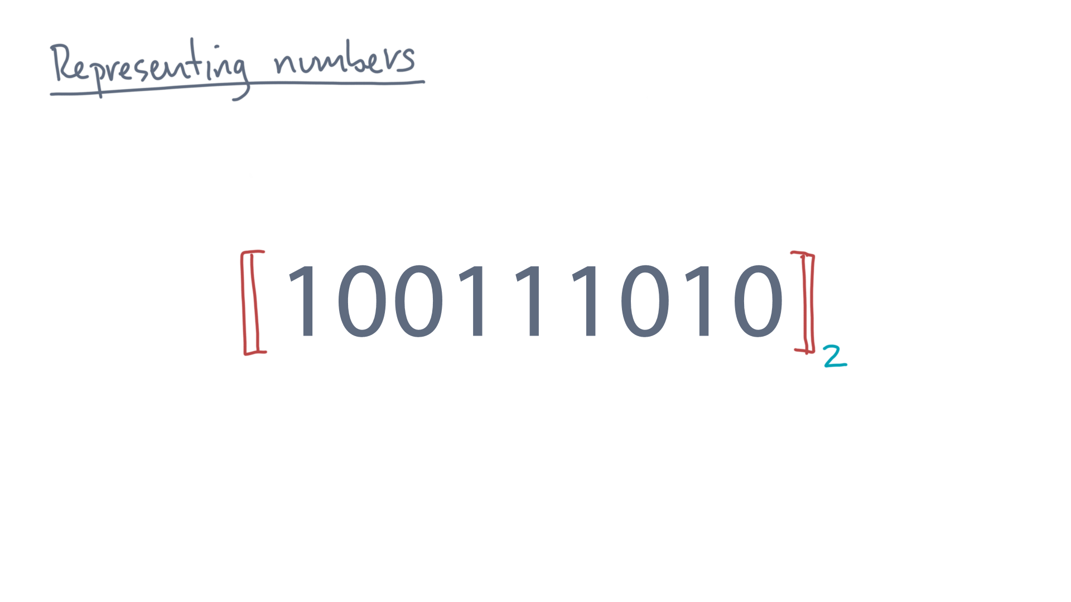
Notes:
Let’s apply the same ideas as before:
First, every digit has its place.

Slide 25
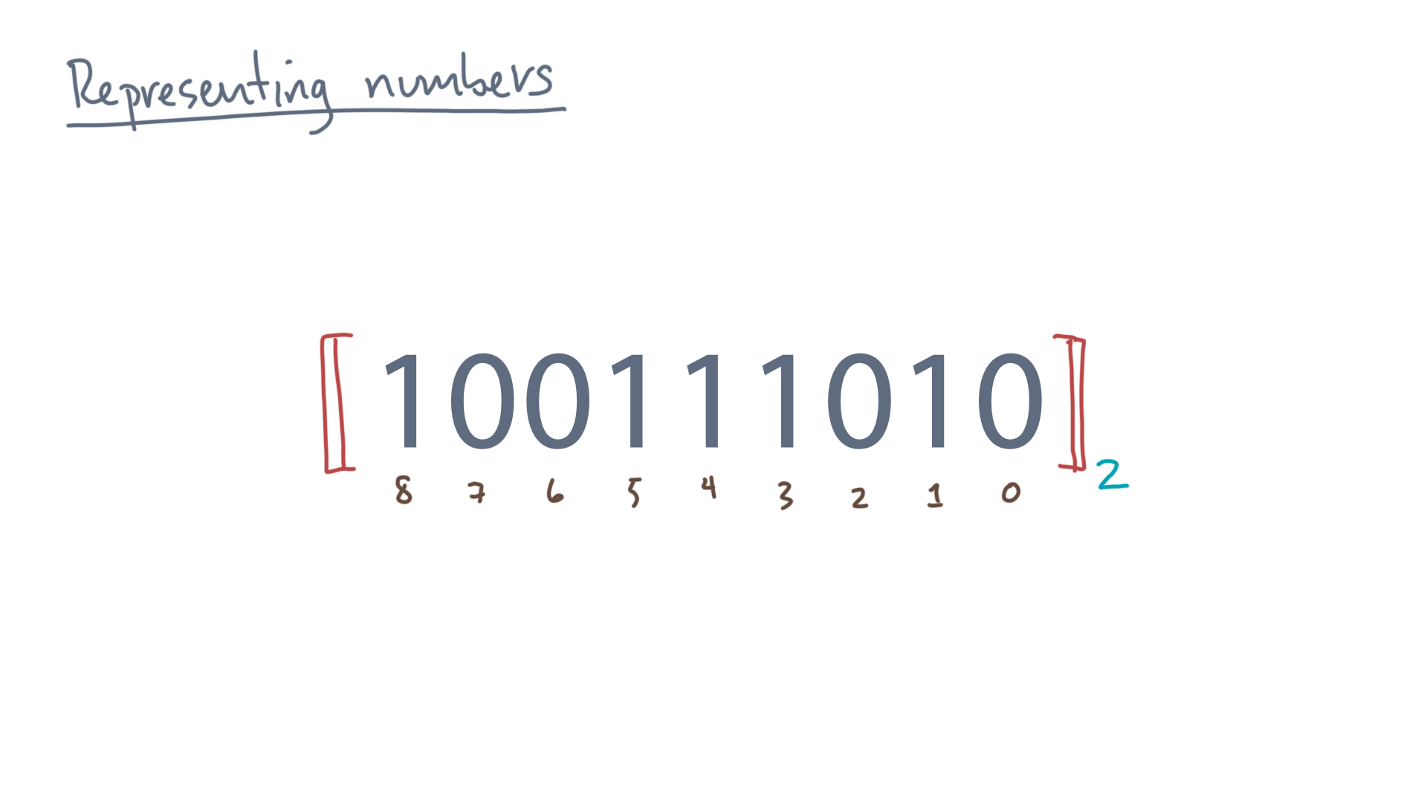
Notes:
The mathematical value is just the sum of what each digit contributes.

Slide 26
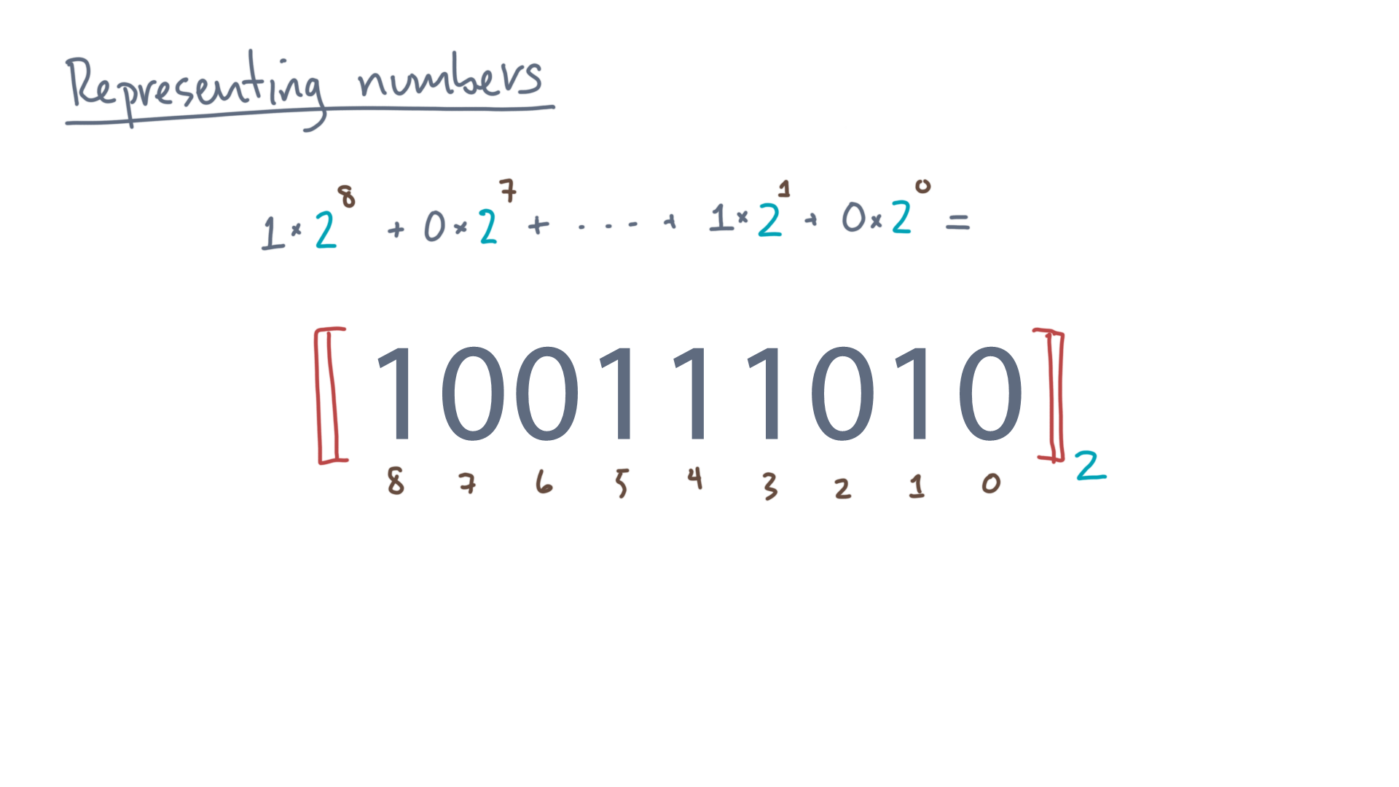
Notes:
In this example, 1 times 2 to the 8th, plus 0 times 2 to the 7th, plus 0 times 2 to the 6th, and so on.
At this point, I think you can work out the rest.
Now one more … bit of terminology.

Slide 27
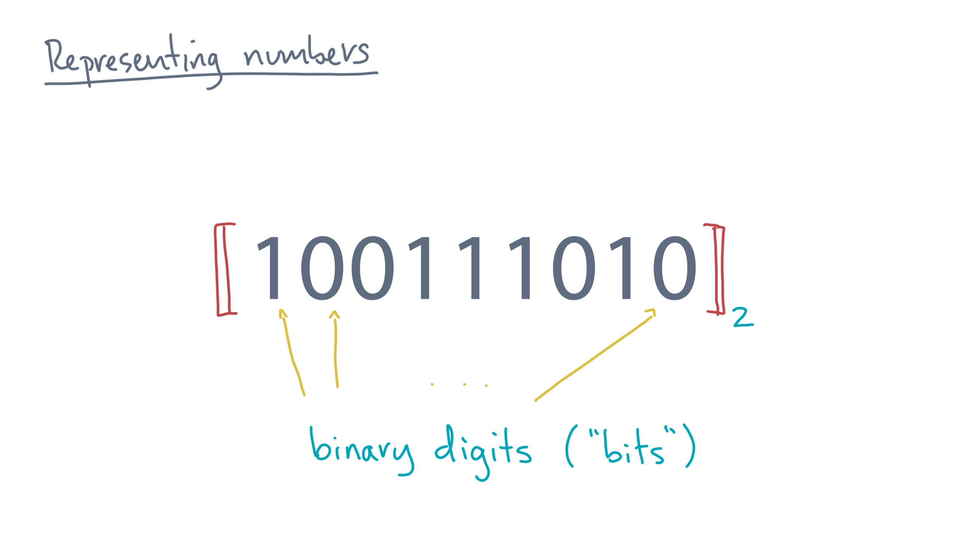
Notes:
The term “bits” is just a shorthand for “binary digits,” in case you didn’t already know.
(With this bit of knowledge, you’ll look and sound like a real computer scientist at your next cocktail party, I guarantee!)

Slide 28
Notes:
Again, I realize we started with what probably seems like a really simple concept and beat it senseless.
But the main concept, which is to think of numbers as strings of digits, is the basic foundation of all of digital computing as we know it today!
Now is a good time to pause and have you do some mental exercises to reinforce these concepts.
When you return, we’ll look at how to extend these basic concepts to represent not just integers, but also real numbers.
Which, I gather, is what you need to do all that fancy number crunching.
And sell me even more things I don’t actually need, or whatever it is you do with those crunchy bits.

